Slide 1
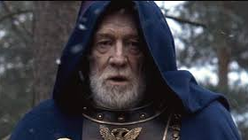
Marcus Aurelius
SELF-HELP EXEMPLAR
Presenter: Tom Butler-Bowdon

Slide 2
Background
My focus: theory and practice of personal development and “success” – from Marcus Aurelius to Anthony Robbins
My personal practice: more into Buddhism than Stoicism. But fascinated by Stoic practices as means to personal growth
Title “Marcus Aurelius as self-help exemplar” i.e. self-help as shorthand for human potential

Slide 3
Presentation Outline
Marcus as symbol & product of Stoic philosophy
Peter Sloterdjik’s idea of “human as trainer”
Stoicism as form of psychological immunity
Nietzsche, Wittgenstein, Foucault on the “vertical” human
Stoic heterotopia
Marcus as archetypal human-in-training

Slide 4
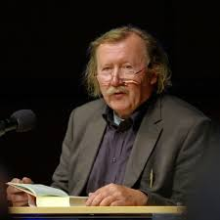
A practicing species
German philosopher Peter Sloterdijk (born 1947): Humans are essentially a practising species: “Planet of the Practising”
Anthropotechnics – the study of the way humans works on themselves, make themselves
“Small human forces can achieve the impossible if they are multiplied by the longer distance of practice.” (Sloterdjik)
Self-forming or self-enhancing behaviour: working to goals
Homo repetitivus, Homo artista – “the human in training”
Most self-development practices grew out of religion – then became secularized

Slide 5
Marcus as homo artista
Our image of him: standing firm against the constant attacks on Rome by barbarians, plagues, internal political turmoil
He has made himself like this. No-one is born this philosophical:
“Be like the headland against which the waves break and break: it stands firm, until presently the watery tumult around it subsides once more to rest. ‘How unlucky I am, that this should have happened to me!’ By no means; say, rather, ‘How lucky I am that this has left me with no bitterness; unshaken by the present, and undismayed by the future.”
- Marcus Aurelius, Meditations

Slide 6
Was Marcus different?
But in what ways is Marcus different to a person of today, who strives for mental and physical health and a good life? How was Marcus’ outlook different to a medieval Christian, say, or a Hindu or Buddhist ascetic?
The truth: he was not that different.
All humans: 1) seek immunity from suffering, and 2) seek to realize their potential.
What differs is the specific practices and outlooks (that differ in time and place) we adopt to achieve this immunity and this realization.

Slide 7
Stoic defense against suffering
Religion has always provided the key form of immunity from suffering. Believers get a sense of community and reverence, and maybe liberation from sins and immortality.
Marcus Aurelius endured plenty of suffering, but Stoic ideals helped him see everything within context of vast cosmic picture.
Daily struggles can be handled with exercises like “View from above”

Slide 8
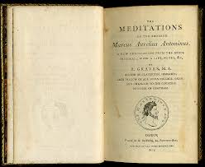
Altogether, human affairs must be regarded as ephemeral, and of little worth: yesterday sperm, tomorrow a mummy or ashes. - Marcus Aurelius
Names that were virtually household words are virtually archaisms today. All things fade into the storied past, and in a little while are shrouded in oblivion. Even to men whose lives were a blaze of glory this comes to pass.
- Marcus Aurelius

Slide 9
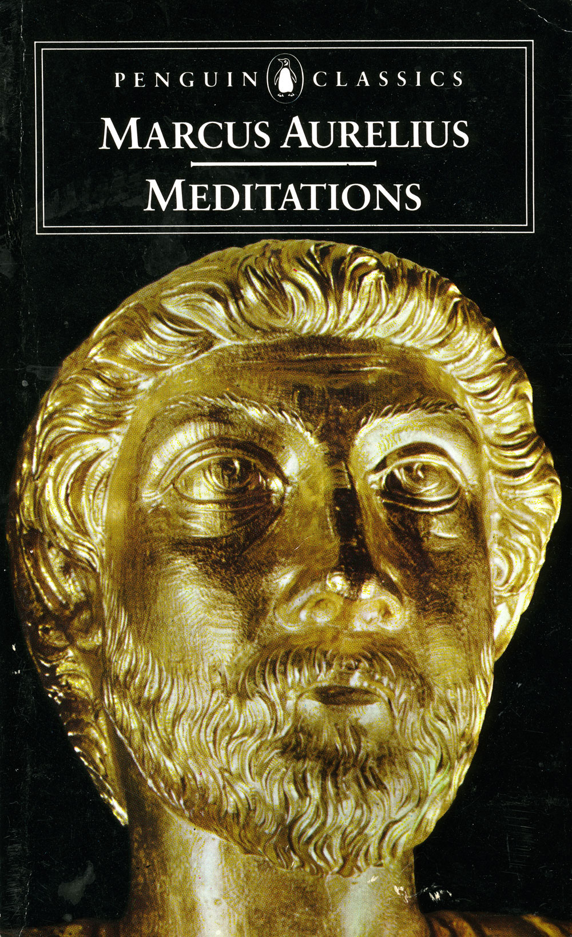
Marcus as product
We see Marcus as a “great man”, a true individual
Better way to see him: a product of centuries of Stoic teaching and practices
First part of the Meditations he lists the people who had influenced him, including Sextus, Rusticus and Appolonius.

Slide 10
Marcus’ teachers
Rusticus was well-versed in Epictetus, and communicated his teaching to the young Marcus
“From Apollonius I learned freedom and unwavering caution; and to focus on nothing else, even for a moment, except reason; and to be always the same, in acute pain, on losing a child, and in long illness” – Marcus Aurelius
i.e. through focus on reason one can avoid or ameliorate to some extent emotional pain and avoid getting lost in a swirl or irrational feelings

Slide 11
What Marcus learned
From Sextus he learned about living in accord with nature – specifically, kindness and being even-handed with people, being slow to take offence
Don’t try to force your will on the universe. Agreeableness, and never showing anger or other passions
These all psychological habits that save one from a whole lot of regret, a prime cause of suffering

Slide 12
Modeling and premeditation of death
Marcus learned the Stoic technique of identifying and modelling a wise person, so reducing the chance of making bad mistakes in our younger years, which can cause lifelong regret
Premeditation of death and disaster, so that nothing could surprise you – and therefore cause pain

Slide 13
The two great benefits of adopting the Stoic view:
1) Less suffering, because you’re living in accord with nature and according to reason
2) Fulfilling your potential, because you do not let emotions and negative surprises get in the way of doing your duty

Slide 14
Psycho-immunological practices
Sloterdjik: We head off vulnerability to fate and mortality through imaginary anticipation and mental armor
We seek immunity to life’s physical and biological threats, but we also seek to head off the shadwo of death and chaos through skills, rituals, languages, etiquette, training and exercise, education, habit, custom

Slide 15
Immunization against shock
How ridiculous and how much of a stranger in the universe is he who is surprised at anything which happens in his life.
- Marcus Arelius
An example of an anthropotechnic ‘trick’: by equating all surprises and injuries, one aims to immunize one’s self against the fortunes of life.
Sloterdjik: A practical self-protecting stance, disguised as a spiritual nature-of-the-universe statement.

Slide 16
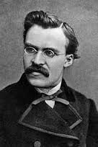
Nietzsche and the practicing human
Nietzsche in Ecce Homo talks about a “doctrine of life practice,” or life as a form of art
Nietzsche: humans are creatures that “will”, that create missions. We need goals and practices
Oswald Spengler in Decline of the West saw Nietzsche’s view as sign of the decline of grand metaphysical worldviews into “mere guides for individuals in their everyday and digestive worries” (Sloterdjik)
Spengler saw the practicization of human life as part of a decline.

Slide 17
Nietzsche’s ascetic planet
Genealogy of Morals, particularly the Third Treatise: Looks at 3,000 years of ascetic or working-on-yourself practices, mental and physical, separate to the religions or spiritual practices they may have been linked to
Nietzsche: If you were an alien looking down on earth, you would see it as the ascetic planet i.e. people disgusted with themselves and with life – trying out anything to move the needle of consciousness and achievement. To achieve that, they had to deny themselves things
Peter Sloterdjik’s view: the ascetic ideal is a largely beneficial advance and a liberation from religion

Slide 18
Humans as vertical species
Other species seek merely to survive and continue their genes.
Human beings: There is always a “vertical” or “acrobatic” dynamic
We are continually practising and moving towards something higher or better
The cultures of antiquity expressed this fulfilment of self two different ways:
The need for heroism and glory
Going with the grain of the universe i.e. “living in accord with nature” (Stoicism)

Slide 19
Stoicism as radical human potential
Stoicism was therefore radical
Less about “success” i.e. glory and achievement (the Nietzschean ‘superman’) than just being the best human you can be e.g. Tim Le Bon’s 29 strengths (self-control, self-awareness, gratitude, resilience, happiness)
Marcus Aurelius’ aim: superficially the defence and maintenance of Rome. Personally, to live up to his own high standards of himself

Slide 20
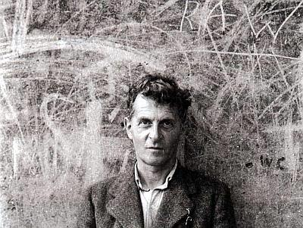
Wittgenstein and verticality
Wittgenstein saw philosophy as a “game” i.e. nothing next to the project of living. Said to an acquaintance:
“Of course I want to be perfect!”
”All religions are wonderful” (meaning, he loved that humans are practicing species ever seeking to go higher, to go beyond the possible)
For Wittgenstein, the meaning of life is choosing to live by a certain standard. The same for Marcus Aurelius

Slide 21
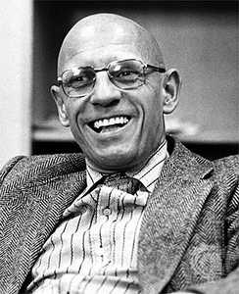
Foucault and personal development
Foucault became interested in the ‘technologies of the self’. Studied the ascetic practices of the Stoic philosophers
Moved away from politics and the irony of the Paris intellectual, towards a more proactive and positive view of humankind
Philosophy as a kind of sport or practice or discipline whose aim was the fulfilment of potential

Slide 22
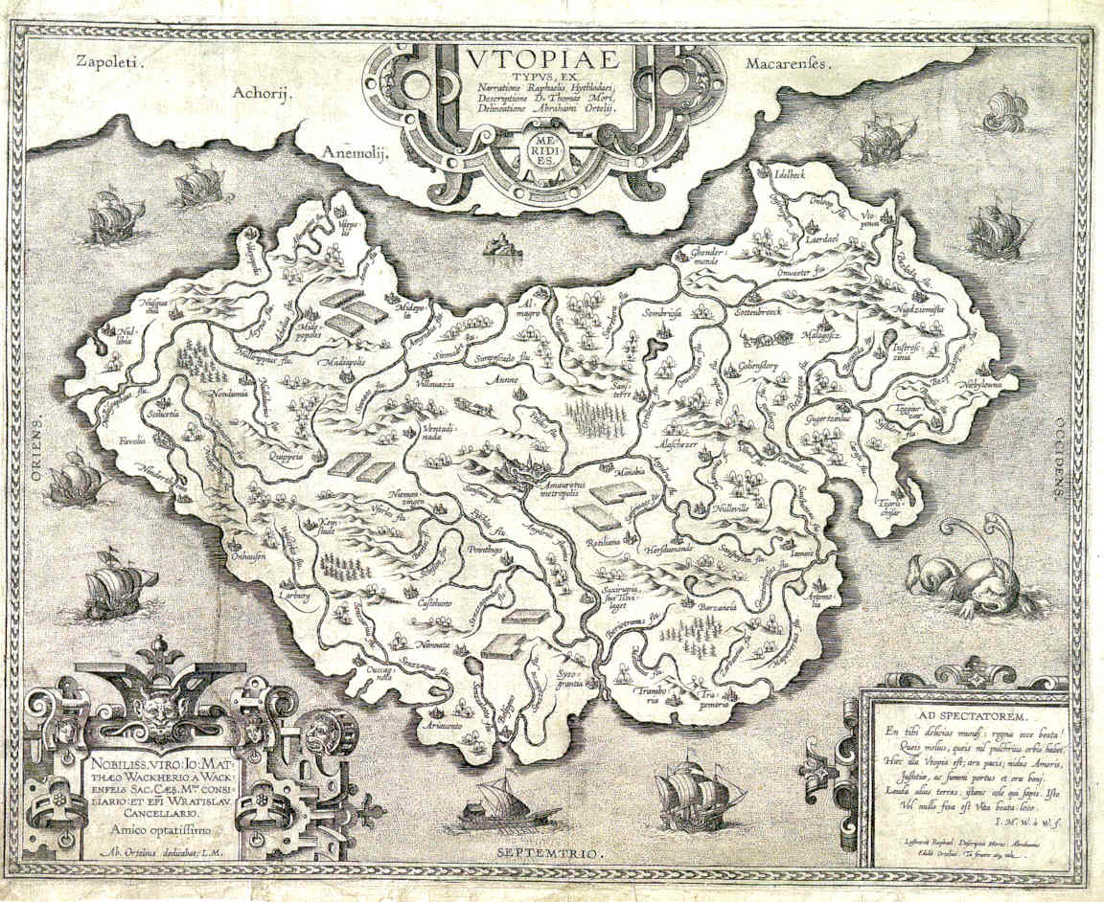
Heterotopias
Utopia: a perfect place.
Heterotopia: a place whose rules or outlook run counter to the rules of society as a whole
Specific arenas to pursue self-technology and self-making e.g. monasteries, libraries, brothels, colonies, ships, holiday islands, space stations (Foucault)
Places marked of as ours within larger society e.g. the sangha, the Christian group. Where one can work on oneself or pursue a mission without distraction.
The Stoics’ heterotopia was a mental one, an area of life and action which they believed to be under their power, and everything else that was not. This was how they came to terms with the universe
Epictetus: separate everything in the world between what is subject to your will, and what is not

Slide 23
Stoic heterotopia
The highest good is already in us. The purpose of Stoic practice is to clear the dark clouds that have appeared from being a person in the world, to reveal the perfect. We need mental space to do this
“Each human transforms themselves into a small state…This polis, after all, is usually taken over by its sole inhabitant in a ruined, almost ungovernable state. Spirituality begins with clean-up work after an inner failed state, a failed soul.” – Peter Sloterdjik
Seneca laid out a five-stage pyramid of spiritual and ethical progress. The highest point (multum desit a summon) affords indestructibility of mind. One is like a rock, intransigent in the face of any kind of mental upheaval or physical torture

Slide 24
The five types of trainer
There are five kinds of life trainers that “aim to give the supra-real the semblance of feasibility and liveability.” (Peter Sloterdjik)
The guru of Hindu tradition
The Buddhist master of the doctrine of liberation
The apostle who shows the way to the imitation of Christ
The philosopher who is witness to the search for truth
The sophist who is an expert on the ways of life
At a lesser level: athletic trainers, masters of a craft or virtuosity, academic professors, regular teachers, and the Enlightenment author

Slide 25
Stoics as philosopher-trainers
Stoic teachers not initiated masters in the Eastern manner, but simply leaders who had worked on themselves
Seneca and Marcus Aurelius as philosopher-trainers. Their “sculptural work on the inner statue” was not that different to today’s training ethos
If we follow their practices, then we can be as they are. Not just a new moral regime, but a practice plan

Slide 26
Stoic training method
Seneca: Desinamus quo voluminous velle! “Let us cease wanting what we previously wanted!”
Humans are bundles of habits. If our habits have prevented us from seeing truth, we need to create new habits.
We become open to a teacher or trainer who openly confronts the built-up identity. We model ourselves on that wise person who has spent decades working on themselves
Stoics “live in accord with nature”: express our highest, best or most virtuous selves. We can reject that potential and live more like an animal, just satisfying our desires
Taking the higher path we need exemplars and constant training

Slide 28
Self-improving society
We live a virtuoso society, a culture of striving
Modernity is a “global fitness exercise” (Sloterdjik) that is inspired by the possibility of an elevated life
The self-improvement project had begun as a religious one, but became scientific
Because Stoicism was more of a moral outlook and a practice than a religion, you can trace a direct line from today’s self-improving society right back to the Stoics

Slide 29
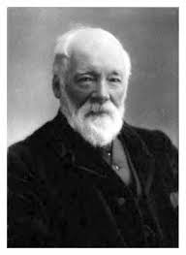
Self or world?
Sloterdjik: a defining feature of modernity is that people don’t quite know whether they should be working on themselves, or working to improve the world
Same question faced Samuel Smiles: crusading political journalist to self-help writer
Marcus faced same question – is my life about working on myself to increase my virtues, or am I living in service of the state?
Stoics sought to reduce the self or ego to be in tune with the cosmos.
Today, people to have all of the gains of work on the self, but not having to give up anything, and particularly not the ego
Why is Stoicism popular today? It combines personal training regime and the drive for a moral existence. Humans need both

Slide 30
Marcus Aurelius – legacy
Anthropotechnics or anthropotechnology – the study of the way man works on himself, makes himself
We look to Marcus as an example – not as guru or enlightened master, but as a self-trainer in mental practices which can make us more resilient and philosophical in the face of life’s dramas… and death
The greatest classical exemplar of the self-help ethic
The Meditations, along with the Bible, the original self-help book
Humans are essentially a practicing species, and Stoicism is perhaps the oldest self-help program, proven over time

Slide 31
Tom Butler-Bowdon
Theory and practice of personal development from Marcus Aurelius to Anthony Robbins
Twitter: @TomButlerBowdon
Email: tombutlerbowdon@gmail.com
Website: Butler-Bowdon.com

